Slide 1
CSE- 271 Software Engineering
Lecture -3

Slide 2
Objectives
To introduce software process models
To describe three generic process models and when they may be used
To describe Iterative Process Models
To describe outline process models for requirements engineering, software development, testing and evolution

Slide 3
Topics covered
Software process models
Process iteration

Slide 4
The software process
A structured set of activities required to develop a
software system
  Specification;
  Design;
  Validation;
  Evolution.
A software process model is an abstract representation of a process. It presents a description of a process from some particular perspective.

Slide 5
Generic software process models
The Waterfall model
  Separate and distinct phases of specification and development.
Evolutionary development
  Specification, development and validation are interleaved.
Component-based software engineering
  The system is assembled from existing components.
There are many variants of these models e.g. formal development where a waterfall-like process is used but the specification is a formal specification that is refined through several stages to an implementable design.

Slide 6
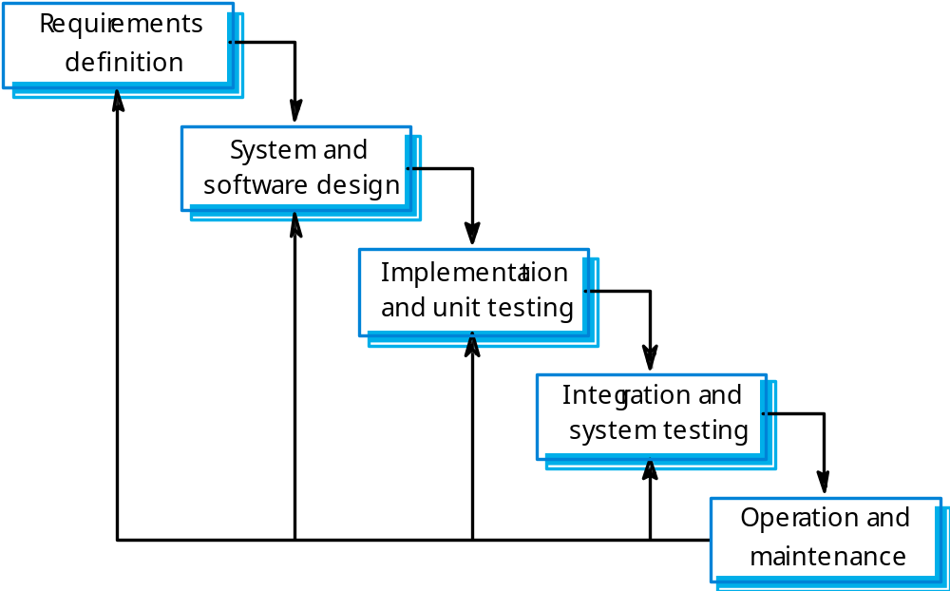
Waterfall model

Slide 7
Waterfall model phases
Requirements analysis and definition
System and software design
Implementation and unit testing
Integration and system testing
Operation and maintenance
The main drawback of the waterfall model is the difficulty of accommodating change after the process is underway. One phase has to be complete before moving onto the next phase.

Slide 8
Waterfall model problems
Inflexible partitioning of the project into distinct stages makes it difficult to respond to changing customer requirements.
Therefore, this model is only appropriate when the requirements are well-understood and changes will be fairly limited during the design process.
Few business systems have stable requirements.
Development teams might wait for each other
A working version of the product is available only late
The waterfall model is mostly used for large systems engineering projects where a system is developed at several sites.

Slide 9
Evolutionary development
Main Characteristics
  The phases of the software construction are interleaved
  Feedback from the user is used throughout the entire process
  The software product is refined through many versions

Slide 10
Evolutionary development
Exploratory development
  Objective is to work with customers and to evolve a final system from an initial outline specification. Should start with well-understood requirements and add new features as proposed by the customer.
Throw-away prototyping
  Objective is to understand the system requirements. Should start with poorly understood requirements to clarify what is really needed.

Slide 11
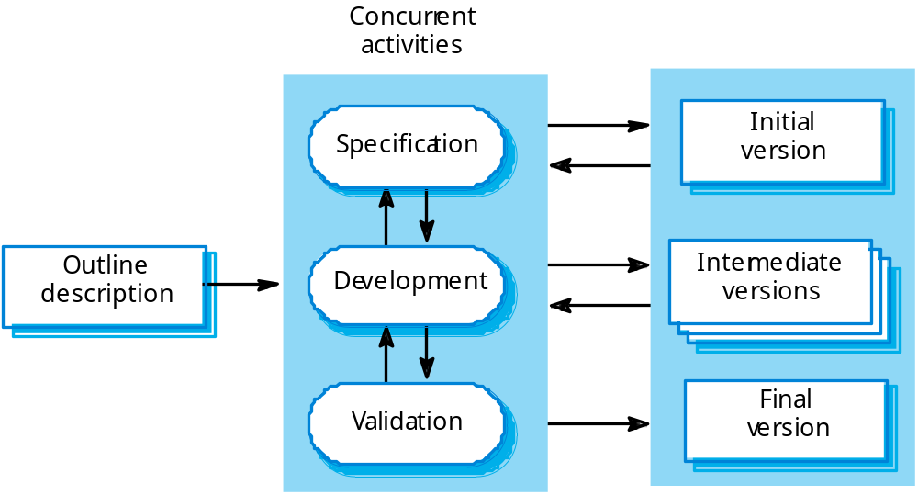
Evolutionary development

Slide 12
Evolutionary development
Advantages
  Deals constantly with changes
  Provides quickly an initial version of the system
  Involves all development teams

Slide 13
Evolutionary development
Problems
  Lack of process visibility;
  Systems are often poorly structured because of continuous change;
  Special skills (e.g. in languages for rapid prototyping) may be required.
Applicability
  For small or medium-size interactive systems;
  For parts of large systems (e.g. the user interface);
  For short-lifetime systems.

Slide 14
Component-based software engineering
Based on systematic reuse where systems are integrated from existing components or COTS (Commercial-off-the-shelf) systems.
Main characteristics:
  Makes intensive use of existing reusable components
  The focus is on integrating the components rather than on creating them from the scratch

Slide 15
Component-based software engineering
Process stages
  Component analysis;
  Requirements modification;
  System design with reuse;
  Development and integration.
Advantages:
  Reduces considerably the software to be developed “in-house”
  Allows faster delivery
  In principle, more reliable systems, due to using previously tested components
This approach is becoming increasingly used as component standards have emerged.

Slide 16
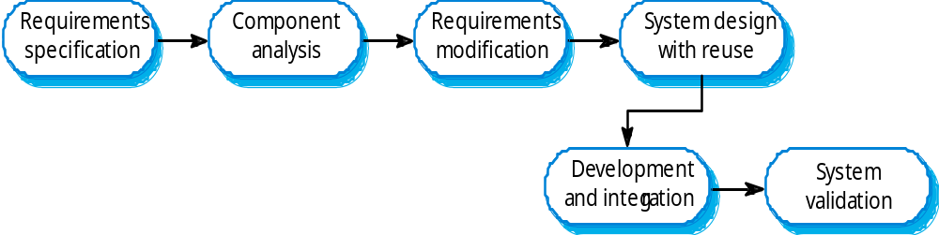
Component-based software engineering

Slide 17
Process iteration
System requirements ALWAYS evolve in the course of a project so process iteration where earlier stages are reworked is always part of the process for large systems.
Iteration can be applied to any of the generic process models.
Two (related) approaches
  Incremental delivery
  Spiral development

Slide 18
Incremental delivery Model
Main characteristics:
  Hybrid model that combines elements of the waterfall and evolutionary paradigms
  The specification, design, and implementation phases are broken in smaller increments

Slide 19
Incremental delivery
Rather than deliver the system as a single delivery, the development and delivery is broken down into increments with each increment delivering part of the required functionality.
User requirements are prioritised and the highest priority requirements are included in early increments.
Once the development of an increment is started, the requirements are frozen though requirements for later increments can continue to evolve.

Slide 20
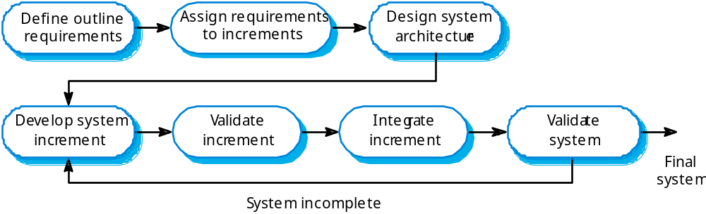
Incremental development

Slide 21
Example: MS Word
First increment:
  basic file management, editing, document production function.
Second increment:
  sophisticated editing and document production capabilities.
Third increment:
  spelling and grammar checking functions
Fourth increment:
  advanced page layout capability

Slide 22
Incremental development advantages
Customer value can be delivered with each increment so system functionality is available earlier.
Early increments act as a prototype to help elicit requirements for later increments.
Lower risk of overall project failure.
The highest priority system services tend to receive the most testing.

Slide 23
Spiral development
Process is represented as a spiral rather than as a sequence of activities with backtracking.
Each loop in the spiral represents a phase in the process.
No fixed phases such as specification or design - loops in the spiral are chosen depending on what is required.
Risks are explicitly assessed and resolved throughout the process.

Slide 24
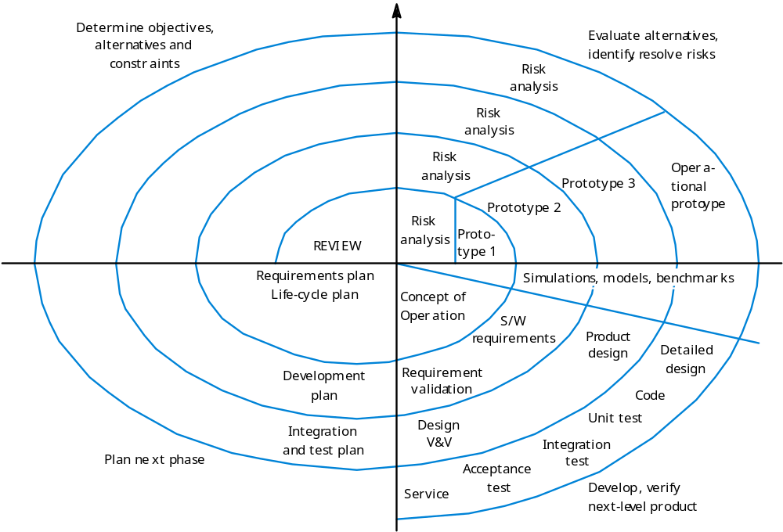
Spiral model of the software process
A Concept of Operations is a document describing the characteristics of a proposed system from the viewpoint of an individual who will use that system.

Slide 25
Spiral model sectors
Objective setting
  Specific objectives for the phase are identified.
Risk assessment and reduction
  Risks are assessed and activities put in place to reduce the key risks.
Development and validation
  A development model for the system is chosen which can be any of the generic models.
Planning next phase
  The project is reviewed and the next phase of the spiral is planned.

Slide 26
Common Experience
Waterfall model is good reference model for documenting the finished product, rarely a good development model.
Iterative development (baseline, then well-defined extensions) is good for deadline-driven projects: at any point there is a finished product.

Slide 27
Common Experience
Prototyping is used when
  Customer defines general objectives but doesn’t identify detailed requirements
  Developer may be unsure of algorithm efficiency, and other UI issues.
  Focus is on understanding the requirements
  Customer and developer should meet and agree on using prototyping model.
  Prototype is initial system, it is discarded and actual quality software is built.

Slide 28
Prototyping vs. Iterative
The objective of throw-away prototyping is to validate or derive the system requirements. The prototyping process starts with those requirements which are poorly understood.
The objective of iterative development is to deliver a working system to end-users. The development starts with those requirements which are best understood.

